Slide 1
North Central Texas
Public Works Emergency Response Team
Mutual Aid Agreement

Slide 2
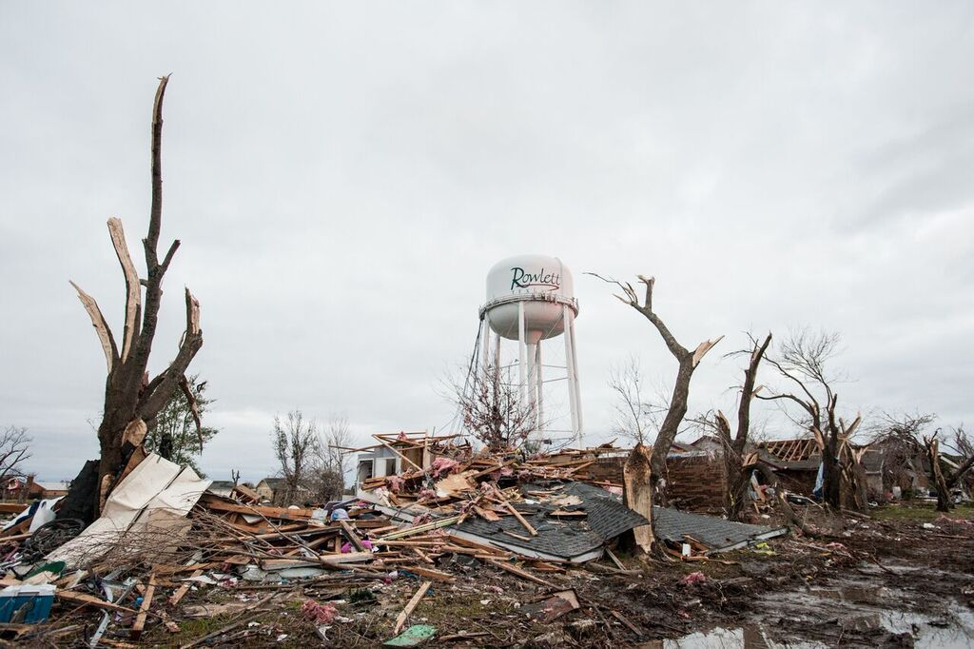
Purpose
Enhance the region’s ability to manage a major emergency overwhelming local resources
A cooperative arrangement that enables jurisdictions to:
  Work out legal and financial issues in advance
  Simplify/streamline the request and assist processes
  Identify available regional resources
  Recover quickly

Slide 3
Scope
Focused on preparedness, initial response, and short-term recovery
  Help stabilize the situation
  Operational Period: 36 hours
Terms of the agreement:
  NIMS approach
  Request for assistance after Disaster Declaration or without declaration if resources only needed for first operational period
  Voluntary support/aid Your choice and ability

Slide 4
Scope
Operational Costs: Everyone pays their own way; no reimbursement for the first operational period
Insurance (workmen’s compensation, auto liability): each party is responsible for it’s own actions
Agreement processing: PWERT will facilitate and be the repository of all associated documents

Slide 5
Process
Signatory Parties
  General Procedures:
    Requesting Agency fill out Checklist & Info Form
    Ask for PEWERT assistance to obtain resources or locate & contact agencies in the agreement
  Responding Agency:
    Analyze & Validate resources available
    Obtain authority to deploy
    Complete Checklist & Info Form
    Dispatch Resources

Slide 6
Process
Other
  Supervision & Control:
    Response operations function under ICS Unified control system
    Responding agency under direct supervision of their designated supervisory
    Maintain all necessary records
    Subject to recall with reasonable notice to requesting agency
  Self Sufficiency: unless mutually agreed, responding agency handles own needs
  Requesting agency ensures communication linkage

Slide 7
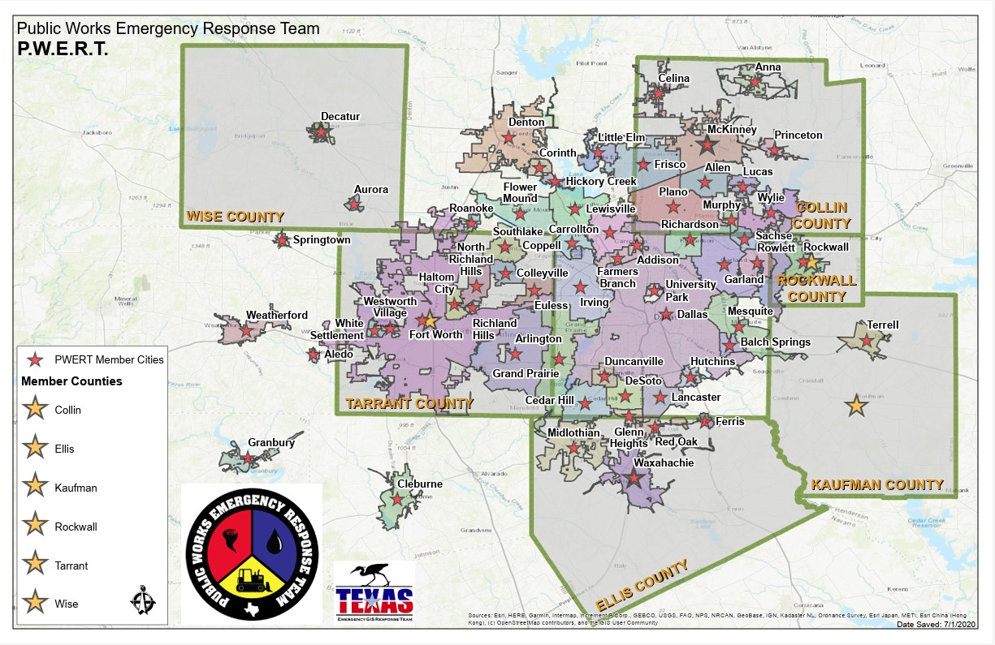
Membership

Slide 8
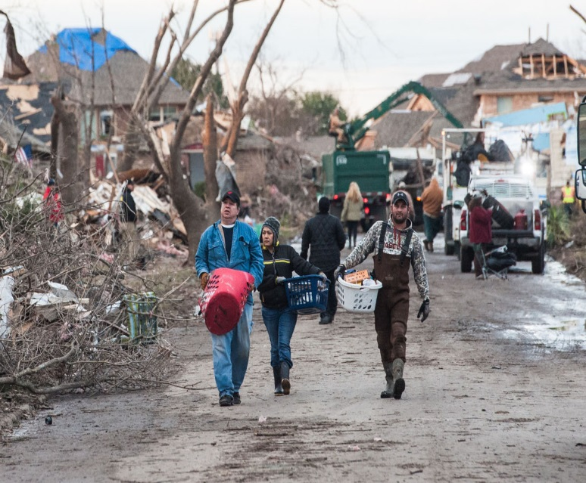
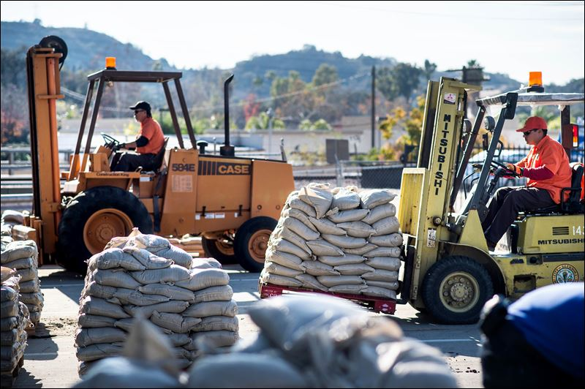
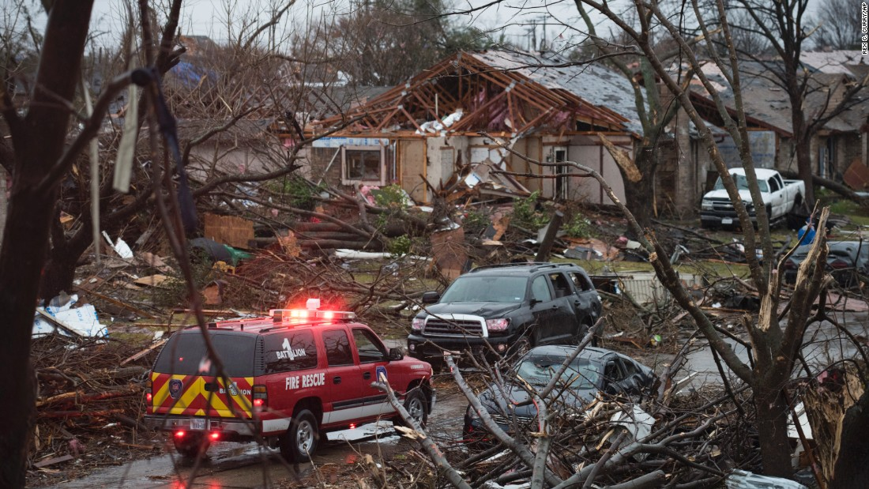
Questions?
PWERT MAA

